Slide 1

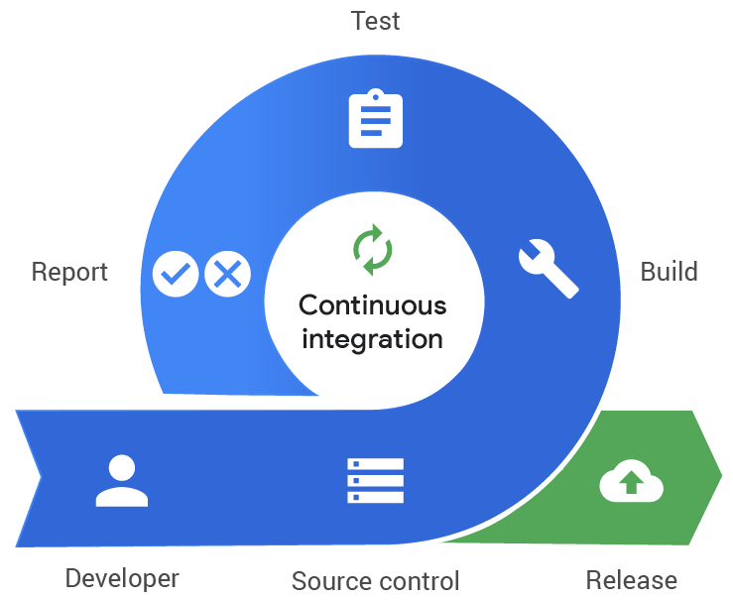
Agile Software Development
Topic: Continuous Integration
Dr. Nikhil Govil
Associate Professor, Program Coordinator – B.Tech. (CSE), Dept. of CEA

Slide 2

Continuous Integration
Continuous Integration (CI) is the practice in software engineering, of merging all developer working copies with a shared main line several times a day.
It was first named and proposed by Grady Booch.
It was adopted as part of extreme programming (XP).

Slide 3
Continuous Integration
CI typically use a build server to implement continuous processes of applying quality control, in general- small pieces of effort, applied frequently.
In addition to running the unit and integration tests, such processes facilitate manual QA processes.
This continuous application of quality control aims to improve the quality of software, and to reduce the time taken to deliver it.

Slide 4
Principles of Continuous Integration
1. Maintain a code repository–
This practice advocates the use of a revision control system for the project’s source code. All artifacts required to build the project should be placed in the repository.
2. Automate the build–
A single command should have the capability of building the system. Many build-tools, such as Make, Debian DEB, Red Hat RPM or Windows MSI files.

Slide 5
Principles of Continuous Integration
3. Make the build self-testing-
Once the code is built, all tests should run to confirm that it behaves as the developers expect it to behave.
4. Everyone commits to the baseline everyday-
By committing regularly, every committer can reduce the number of conflicting changes.
5. Every commit (to baseline) should be built-
The system should build commits to the current working version to verify that they integrate correctly.

Slide 6
Principles of Continuous Integration
6. Keep the build fast-
The build needs to complete rapidly, so that if there is a problem with integration, it is quickly identified.
7. Test in a clone of the production environment-
Having a test environment can lead to failures in tested systems when they deploy in the production environment, because the production environment may differ from the test environment in a significant way.
8. Make it easy to get the latest deliverables-
Making builds readily available to stakeholders and testers can reduce the amount of rework necessary when rebuilding a feature that doesn't meet requirements.

Slide 7
Principles of Continuous Integration
9. Everyone can see the results of the latest build-
It should be easy to find out whether the build breaks and, if so, who made the relevant change.
10. Automate deployment-
Most CI systems allow the running of scripts after a build finishes.

Slide 8
Benefits of Continuous Integration
1. Integration bugs are detected early and are easy to track down due to small change sets.
2. Avoids last-minute chaos at release dates.
3. Constant availability of a “current” build for testing, demo, or release purposes.
4. Frequent code check-in pushes developers to create modular, less complex code.

Slide 9
References
Ken Schawber & Mike Beedle, Agile Software Development with Scrum, Pearson, 2008.
Robert C. Martin, Agile Software Development, Principles, Patterns and Practices, Prentice Hall,2002.
Lisa Crispin & Janet Gregory, Agile Testing: A Practical Guide for Testers and Agile Teams, Addison Wesley, 2008.
Alistair Cockburn, Agile Software Development: The Cooperative Game, Addison Wesley, 2006.

Slide 10


